Slide 1

Analysis of 2019 Airbnb listings in New York City
By: Rosy Abreu

Slide 2

Outline:
Introduction & About the Dataset
Methodologies
Discoveries
References
Conclusions

Slide 3
Introduction & About the Dataset
Goal of this analysis
To get better understanding of which locations / place types are most booked in NYC.
Dataset information
Dataset from Kaggle.com
44895 rows and 16 columns
Data types: integers, floats, objects
Columns include: Airbnb place name, room type, host details,
location, price per night, # of reviews, etc.

Slide 4
Methodologies used for Analysis
Imported libraries
Pandas, Seaborn, Matplot, Numpy
Cleaned and grouped data
Renamed all columns, changed NaN values to 0, filtered, and created groupby functions to compare data.
Statistics
Created data visuals with seaborn

Slide 5
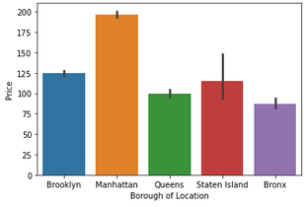
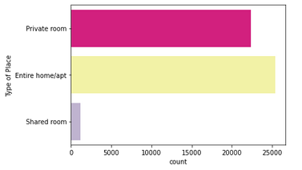
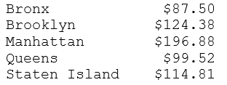

Discoveries during Analysis
Which type of place gets booked the most?
Which borough has the highest prices per night?
Other Discoveries:
Allerton area in the Bronx had minimum values.
Overall average of prices per night was $152.72
Overall average of minimum nights is 7 days

Slide 6

References
Resources:
https://www.kaggle.com/dgomonov/new-york-city-airbnb-open-data?select=AB_NYC_2019.csv
https://stackoverflow.com
Class lecture PowerPoints
https://github.com/msrosyabreu/PROJECTS-RA
Google Colab
Airbnb.com

Slide 7
Conclusion
Final thoughts.
In 2019, Manhattan and Brooklyn Airbnb rentals were booked the most.
Types of places booked the most were entire home/apt.
Most expensive rates per night are Manhattan and Brooklyn.
Any questions?
Thank you!
The end.

